Slide 2
U.S. Small Business Administration Services & Loans
Business & Commerce Subcommittee
Labor, Commerce, & Industry Committee
South Carolina House of Representatives
Monday, July 28, 2025 (10:00 a.m.) – Blatt Building, Rm. 10
Melissa L. Lindler
South Carolina District Director
U.S. Small Business Administration (SBA)
July 28, 2025

Slide 3
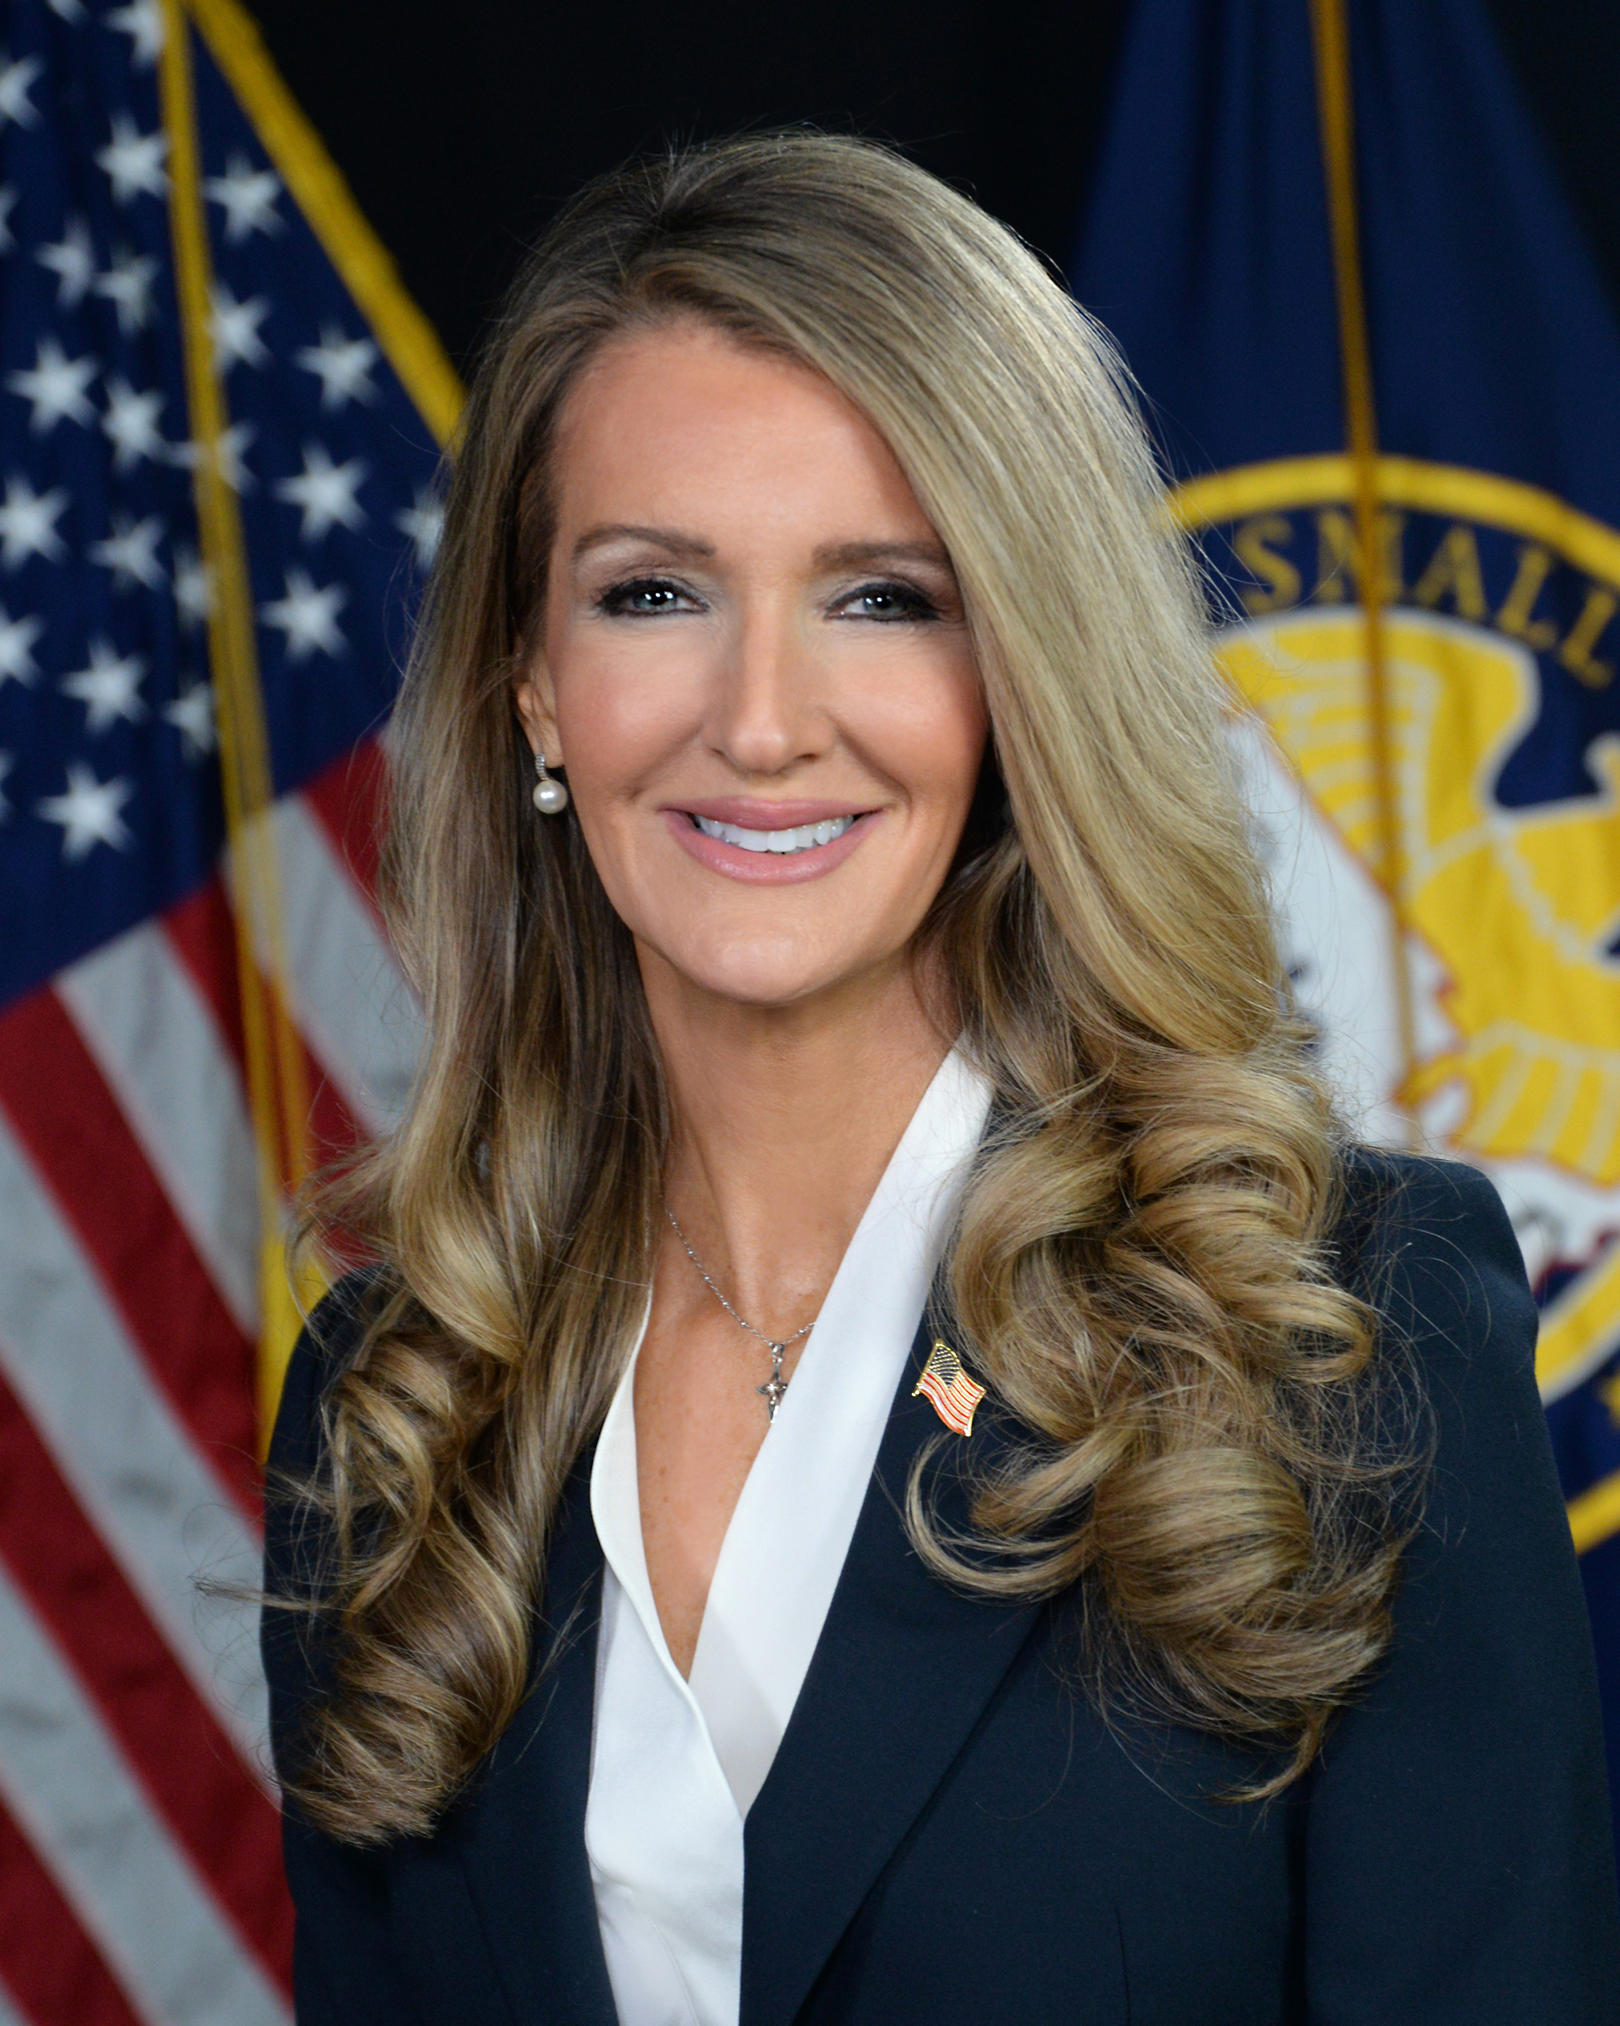
With the Made in America Manufacturing Initiative, we’re slashing red tape, expanding access to capital, and fueling a manufacturing resurgence that will create high-paying jobs and revitalize communities across the country. By prioritizing American-made products, we’re not just securing our economic dominance — we’re protecting our national security by ensuring the essential goods we rely on are produced right here at home.
Kelly Loeffler, SBA Administrator
Kelly Loeffler
Administrator
U.S. Small Business Administration

Slide 4
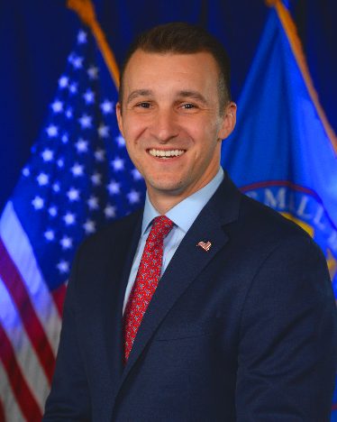
Regional Administrator
Tyler Teresa
Southeast Regional Administrator
U.S. Small Business Administration

Slide 5
Small Businesses are Key Drivers of South Carolina’s Economy
530,402
small businesses operate in S.C.
99.4%
of S.C. Businesses
42.9%
of S.C.’s private workforce is employed by a small business
SBA’s 2025 Small Business Profile
Sources of original data: Nonemployer Statistics (Census), Statistics of U.S. Businesses (Census)

Slide 6
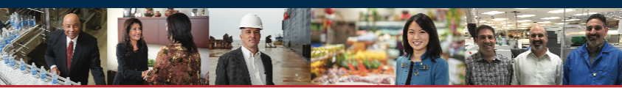
The SBA works to ignite change and spark action so small businesses can confidently
START • GROW • EXPAND • RECOVER

Slide 7
SBA’s CORE Services
Entrepreneurial Development – Training, Counseling, & Mentorships
Government Contracting -- Certifications & Guidance
Access to Capital (SBA Loan Guarantees and Microloans)
Home & Business Disaster Loans
7

Slide 8
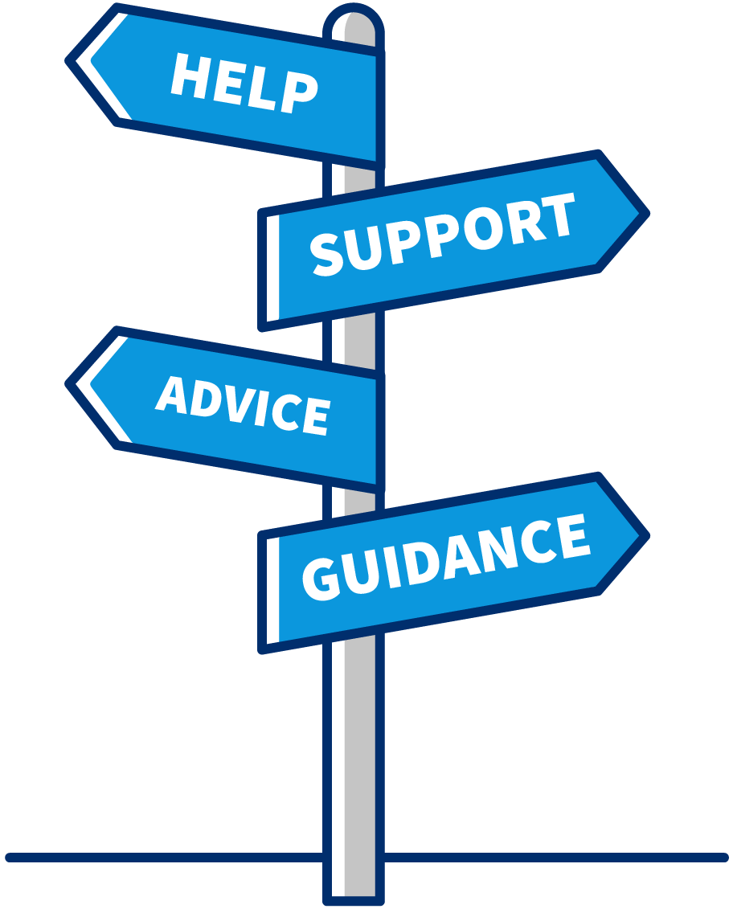
The SBA Resource Partner Network
SCORE Mentors throughout the state www.score.org
SBDCs located throughout the state https://www.scsbdc.com
Women’s Business Centers
Benedict Women's Business Center (Columbia)
EmpowHER Women’s Business Center (Barnwell)
I-Hope Women's Business Center (Charleston)
Veteran’s Business Outreach Centers
VBOC - The Veterans Transformational Learning Initiative (citadel.edu)
Notes:
Talking Points:
When you need reliable advice to start or grow your business, the SBA can connect you with experts who understand the business climate at both a national level, as well as in your specific region or market.
The SBA’s Resource Partner Networks helps to extend our reach to serve the nation’s small business community outside of our District Offices.
Whether you need to create successful business plan, get expert advice on expanding your business, or train your team, the SBA makes sure you’re never far from the help you need.
In FY 2017, over 1.4 million small business owners received counseling or training from an SBA resource partner.
You can find resource partners closest to you using our local partners search page at SBA.gov/local-assistance.
Tips:
Provide a few examples of experts and resource partners in your community in your community.
Distribute or reference the associated Fact Sheet.

Slide 9
Important Technical Assistance from SBA &
Resource Partners
Cash flow management/short term, financial management;
Business plan assistance;
Loan packaging assistance;
Messaging/Social Media
Import/Export assistance;
Supply chain;
Strategic and succession planning;
Risk management;
Disaster preparation and recovery.

Slide 10
FY2024 Performance of SC Resource Partners
 | Unique Clients Trained | Unique Clients Counseled | Jobs Supported | New Business Starts | Capital Infusion
SCORE | 2,351 | 2,096 | 2,423 | 184 | $0
SBDC | 684 | 3,872 | 29,649 | 153 | $65,213,782
WBC | 452 | 438 | 1,010 | 17 | $2,371,300
Totals | 3,487 | 6,406 | 33,082 | 354 | $67,585,082

Slide 11
Government Certification & Contracting
Targeted acquisition goals:
Women-Owned Small Businesses (including EDWOSB) (5%)
Amounts are reserved for small businesses between $10,000 (Micro purchase Threshold) to $250,000 (Simplified Acquisition Threshold)
Small Disadvantaged Businesses (including 8(a)) (5%)
HUBZone Businesses (3%)
Service-Disabled Veteran-Owned Small Businesses (5%)

Slide 12
Administration Priorities
Transforming SBA into an America-first engine of economic opportunity, with renewed emphasis on domestic manufacturing and fiscal responsibility;
Instituted a Zero-Tolerance approach to Fraud and Waste;
Removing Regulatory Barriers for small businesses;
Improving Disaster Preparedness and Recovery Response;
Increasing loan caps for 7(a) and 504 programs; and
Ensuring Rural Small Businesses have Access to SBA Resources and Products.
12

Slide 13
Removing Barriers to Small Business
Growth & Development
Red Tape Hotline
As the watchdog for small businesses in the regulatory process, the Office of Advocacy works to restrain regulations that impose excessive costs on small businesses. Advocacy empowers you to make your voice heard in the regulatory process. If you have a concern with a federal regulation, please reach out and let us know.
Email: redtape@sba.gov or
Call: 800-827-5722 and select option 3

Slide 14
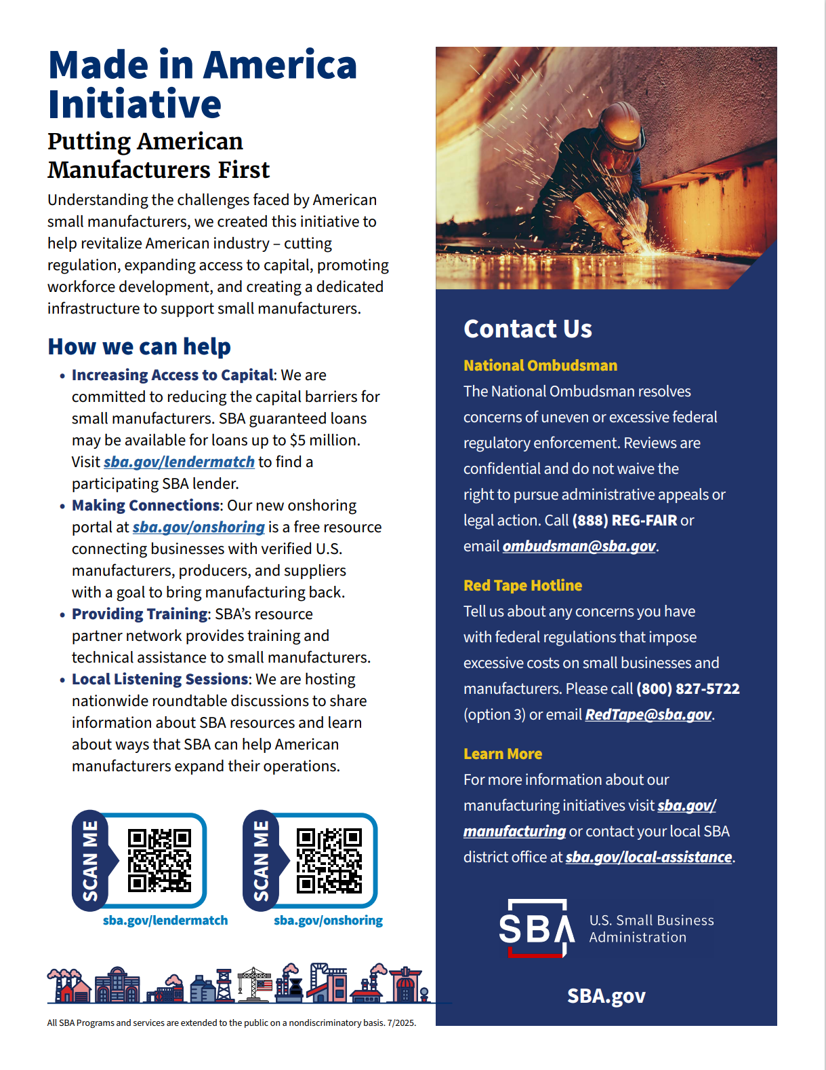
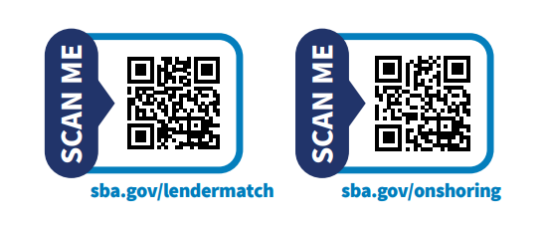
SBA’s Made in America
Manufacturers Initiative
Increase access to capital
Improve opportunities for public and private investments in support of manufacturing in America
Help small businesses export their products on a global scale

Slide 15
New/Renewed Partnerships & Outreach
SC Department of Commerce
SC Manufacturers Alliance (SCMA)
SC Research Authority (SCRA)
SC Economic Development Association (SCEDA)
SC Manufacturing Extension Partnership (SCMEP)
Local Chambers of Commerce
APEX Accelerator
USDA Farm Service Agency (FSA)
USDA Rural Development
Local & County Governments

Slide 16
Manufacturing in South Carolina – 3,079
Nearly $10B investment in the electric vehicle industry
Building Upon the Manufacturing Success in SC
Manufacturing employment growth of more than 17% over the last 10 years
Leading the nation in export sales of tires and passenger vehicles

Slide 17
NEW: Office of Manufacturing & Trade - Going Global
Counseling & Training
Trade Tools for International Sales
U.S. Export Assistance Centers (USEACs)
SBDCs
Find Buyers Internationally
State Trade Expansion Program (STEP)
Get Export Funding
Export Express Loans
Export Working Capital Loans
International Trade Loans

Slide 18
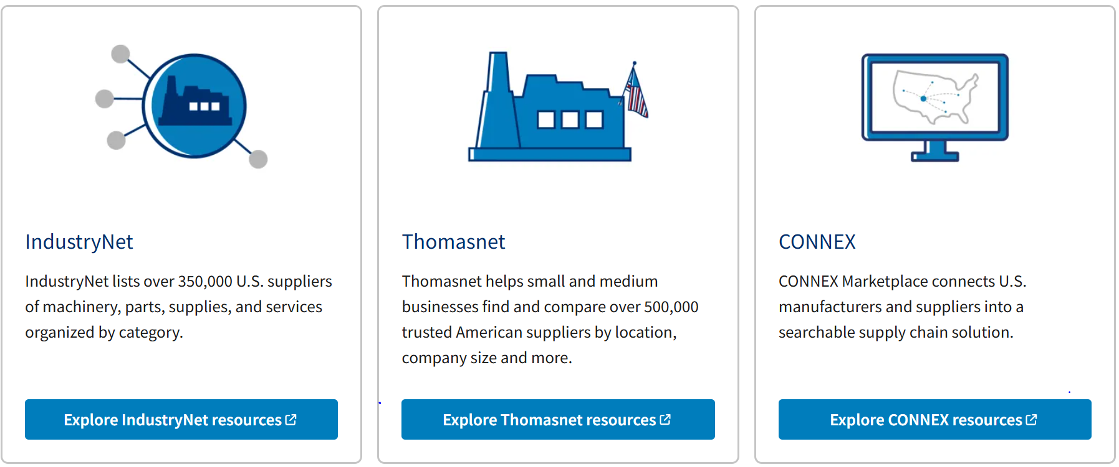
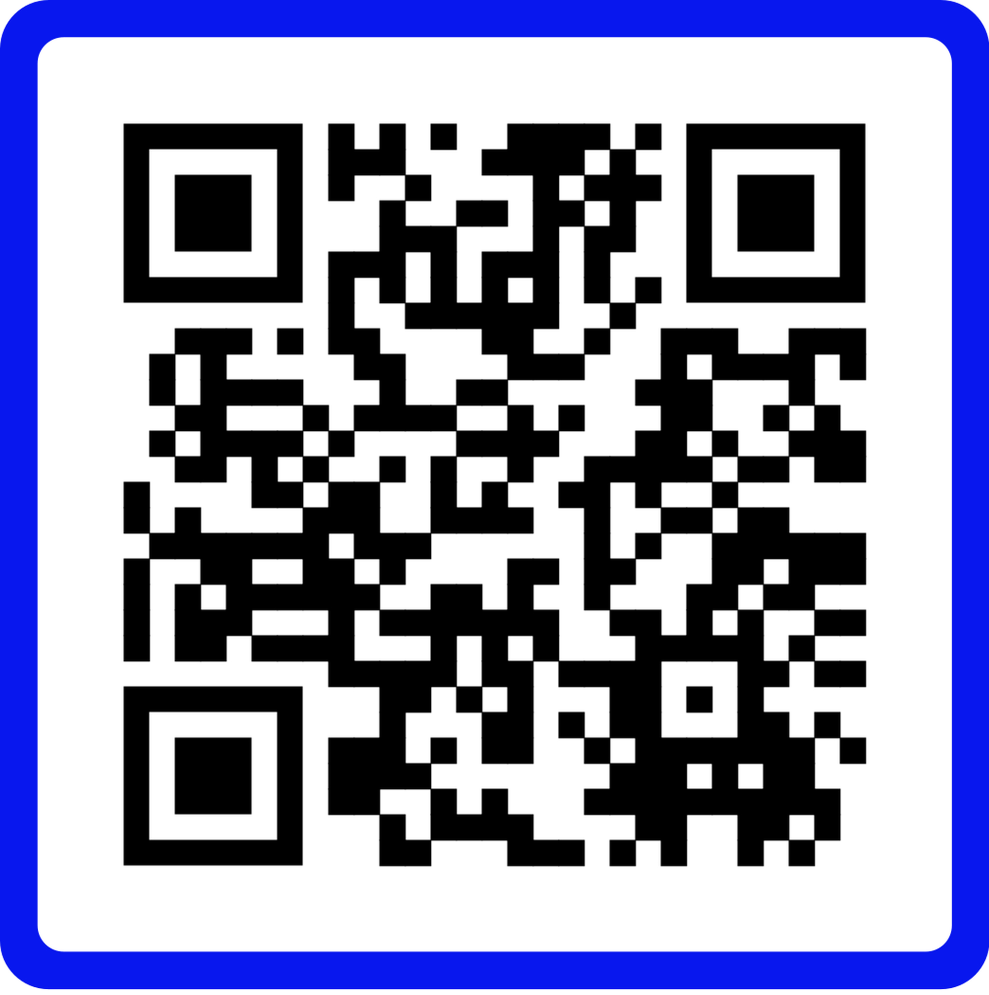
NEW - SBA Onshoring Portal
This free tool from SBA helps connect businesses with verified U.S. manufacturers, producers, and suppliers. It’s built to support companies that want to onshore operations, strengthen their supply chains, and source the components they need—all proudly Made in the USA.
sba.gov/onshoring

Slide 19
SBA Loans Offer Solutions Throughout the Entire Life
Cycle of a Small Business
Growth
Start Up
Increase Profits
Working Capital
Grow Sales
Fixed asset refinance
Fixed asset acquisition
Purchase order and contract financing
Working Capital
In FY24, SBA guaranteed $487M in loans for 842 S.C. Small Businesses.

Slide 20
Benefits of SBA – Guaranteed Loans
Competitive terms: SBA-guaranteed loans generally have rates and fees that are comparable to non-guaranteed loans.
Counseling and education: Some loans come with continued support to help you start and run your business.
Unique benefits: Lower down payments, flexible overhead requirements, and no collateral needed for some loans.
Direct loans from lender: Money comes directly from Lender
Shared risk: SBA offers Lender a guarantee to share in risk
Notes:
Loans
Start or expand your business with loans guaranteed by the Small Business Administration. Use Lender Match to find lenders that offer loans for your business.
How SBA helps small businesses get loans
The U.S. Small Business Administration helps small businesses get funding by setting guidelines for loans and reducing lender risk. These SBA-backed loans make it easier for small businesses to get the funding they need.
In order to get an SBA-backed loan:
Visit our Loans page to find the loan that best suits your need
Enter your Zip Code on Lender Match to find a lender in your area
Apply for a loan through your local lender
Lenders will approve and help you manage your loan
SBA only makes direct loans in the case of businesses and homeowners recovering from a declared disaster.
Loans for borrowers
Woman working on a lap top
7(a) loans
A group of SBA loans which guarantee portions of the total amount, cap interest rates, and limit fees.
Read more about 7(a) loans
Woman working in a computer lab
504 loans
Long-term, fixed-rate financing to purchase or repair real estate, equipment, machinery, or other assets.
Read more about 504 loans
Man and woman looking at lap top at kitchen table
Microloans
Our smallest loan program, providing $50,000 or less to help businesses start up and expand.
Read more about microloans

Slide 21
General Eligibility
Operate for profit (typically active, non-speculative businesses)
Be considered a small business, as defined by SBA
Be engaged in, or propose to do business in, the U.S. or its territories
Have reasonable owner equity to invest
Not be delinquent on any existing debt obligations to the U.S. government
Use alternative financial resources, including personal assets, before seeking financial assistance
  This step of eligibility will be established while working with your lender
    Credit Not Available Elsewhere
    Owner available liquidity
Notes:
Be a for-profit business
The business is officially registered and operates legally.
A U.S. flag over an outline of the country.
Do business in the U.S.
The business is physically located and operates in the United States or its territories.
A pie chart.
Have invested equity
The business owner has invested their own time or money into the business.
A rejected loan application.
Exhaust financing options
The business cannot get funds from any other financial lender.

Slide 22
Access to Capital – SBA Loan Programs
7(a) Loans (up to $5M)
7(a) Small Loans (any 7(a) loan that is $500,000 and under)
SBA Express Loans (up to $500,000)
SBA Loans to Veterans (up to $500,000)
CAPLines (lines of credit, up to $5M)
Community Advantage (up to $500,000)
Working Capital Pilot (up to $5M)
International Trade Loans (up to $5M)
Export Working Capital Loans (up to $5M)
Export Express Loans (up to $500,000)

Slide 23
Access to Capital – SBA Loan Programs (Continued)
504 Loans (maximum amounts ranges from $5M - $5.5M; these loans are made through Certified Development Companies (CDCs) which are licensed through SBA
504 Loan Refinancing Program (same as 504)
Non 7(a) Microloans (up to $50,000; these loans are made through nonprofit community-based organizations with experience in lending, management, and technical assistance)

Slide 24
SBA Disaster Recovery Loan Assistance (SBA Direct Loans)
 | Businesses & Nonprofits | Homeowners & Renters
Physical Damage Disaster | Real Estate, Machinery, Equipment, Inventory, & Other Business Assets – Up to $2M | Repair or Replace Homeowner Primary Residence to Pre-disaster condition – Up to $200,000
Damaged Personal Property | N/A | Repair, Replace Furniture, Appliances, Vehicles, and/or Personal Property – Up to $40,000
Max. Loan Amt. | The maximum for any combination of property damage and/or economic injury is $2M | The maximum for any combination of real or personal property damage, voluntary mitigation measures, refinancing, and contractor malfeasance is $840,000
Mitigate Against Future Damage | Yes, increased by 20% of verified physical damage | Yes, increased by 20% of verified physical damage to homeowner’s primary residence
Interest Rates | Low and fixed interest rates based on the date of disaster | Low and fixed interest rates based on the date of disaster
Max. Loan Term | Up to 30 years | Up to 30 years

Slide 25
SBA Loan Activity in South Carolina
 | 2023 |  | 2024 |  | 2025 (to Date)
Program | Approval Count | Approval Amount | Approval Count | Approval Amount | Approval Count | Approval Amount
7(a) | 681 | $371,667,900 | 804 | $437,169,100 | 746 | $390,246,500
504 | 28 | $34,290,000 | 38 | $50,304,000 | 32 | $53,900,000
Disaster | 52 | $2,806,400 | 421 | $13,209,000 | 2,634 | $122,886,400
Microloan | 95 | $2,021,494 | 84 | $1,862,673 | 59 | $1,647,274
Grand Total | 856 | $410,785,794 | 1,347 | $502,544,773 | 3,471 | $568,680,174

Slide 26
Access to Capital – Investment Capital
Small Business Investment Companies (SBICs) Licensed by SBA
An SBIC is a privately owned company that’s licensed and regulated by the SBA. SBICs invest in small businesses in the form of debt and equity. The SBA doesn’t invest directly into small businesses, but it does provide funding to qualified SBICs with expertise in certain sectors or industries. Those SBICs then use their private funds, along with SBA-guaranteed funding, to invest in small businesses.

Slide 27
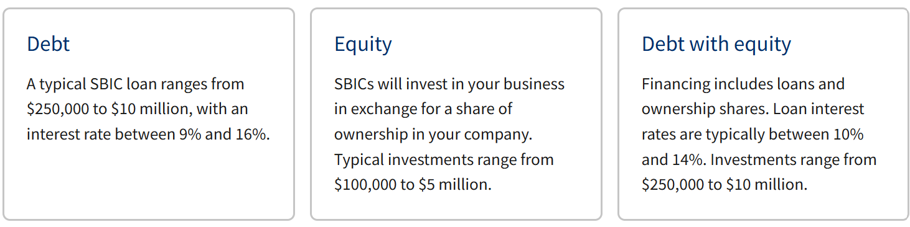
Access to Capital – Investment Capital
SBICs Licensed by SBA

Slide 28
Access to Capital – America’s Seed Fund (SBIR/STTR)
Through the Small Business Innovation Research (SBIR) and Small Business Technology Transfer (STTR) programs, America’s Seed Fund awards equity- free funding to develop technology and chart a path toward commercialization.
Program Goals
Stimulate technological innovation.
Meet Federal research and development needs.
Foster and encourage participation in innovation and entrepreneurship by emerging and undercapitalized SBCs.
Increase private-sector commercialization of innovations derived from Federal research and development funding.

Slide 29
America’s Seed Fund Participating Agencies
U.S. Department of Agriculture (SBIR/STTR)
U.S. Department of Commerce (SBIR)
U.S. Department of Defense (SBIR/STTR)
U.S. Department of Energy (SBIR/STTR)
U.S. Department of Health and Human Services (SBIR/STTR)
U.S. Department of Education (SBIR)
U.S. Department of Homeland Security (SBIR/STTR)
U.S. Department of Transportation (SBIR)
U.S. Environmental Protection Agency (SBIR)
National Aeronautics and Space Administration (NASA) (SBIR/STTR)
National Science Foundation (SBIR/STTR)

Slide 30
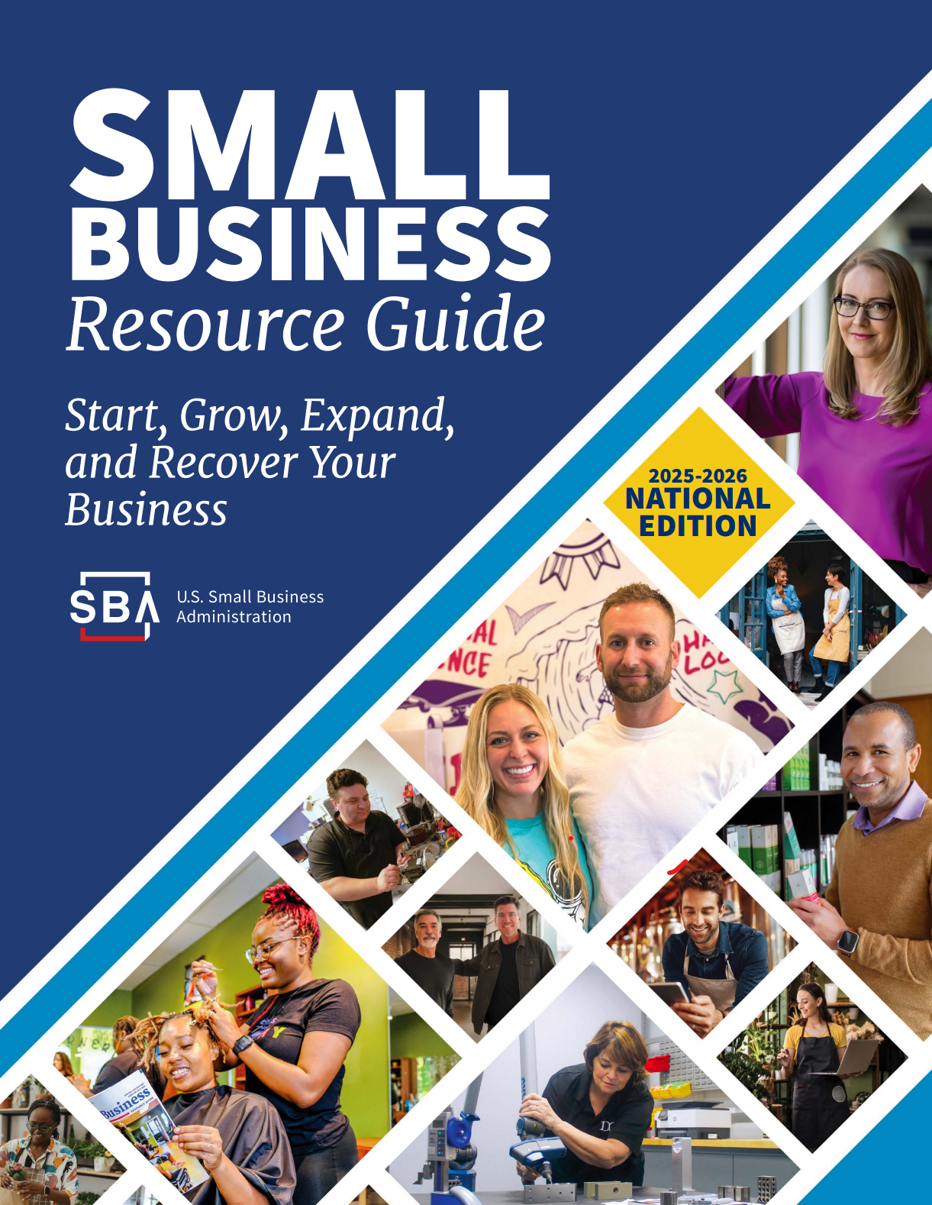
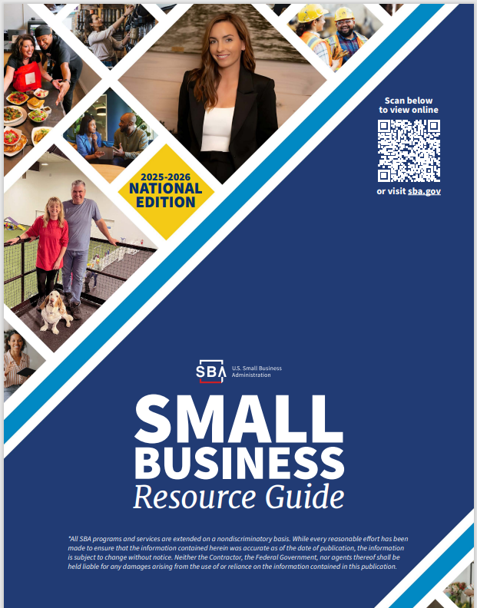
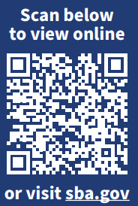
2025 Small Business Resource Guide

Slide 31
Updates
Signed MOU Between SBA & DOL to Support Domestic Manufacturing:
Connect SBA’s capital and contracting tools with DOL’s workforce development infrastructure;
SBA and DOL will expand data-sharing and coordination on programs such as DOL’s Registered Apprenticeship Program and the Veteran Employment Training Service;
SBA will likewise offer cross-agency training on loan programs to support manufacturing, including the 7a and 504 loan programs.

Slide 32
Updates
Congressional Proposal to increase Capital for Small Manufacturers :
Doubles individual loan limits for 7(a) and 504 small business manufacturing loans from $5 million to $10 million; and
Passed the Senate last week, expected to pass the House soon
New SBA Center for Faith (Housed within the Office of Economic Development:
Empower faith-based businesses, community organizations, and houses of worship with access to capital, counseling, and government contracting opportunities.

Slide 33
Contact SBA SC District Office
SBA South Carolina Contact Information
www.sba.gov/sc
South Carolina District Office
1835 Assembly Street, Suite 1425, Columbia, SC 29201
803-765-5377
www.sba.gov/sc
southcarolina_do@sba.gov
Spartanburg Alternate Work Site
1875 E. Main Street, Duncan, SC 29334
803-253-3123

Slide 34
SBA Staff Listing
South Carolina District Office
Melissa L. Lindler
District Director
(202)756-0310 | melissa.lindler@sba.gov
Frank A. Anderson
Lender Relations Specialist
(803) 253-3018 | frank.anderson@sba.gov
Earl Gregorich
Outreach & Marketing Specialist
(803) 253-3123 | earl.gregorich@sba.gov
Angela Brewer
Business Opportunity Specialist
(803) 765-5907 | angela.brewer@sba.gov

Slide 35
Thank You!

